Slide 1

Fairness in Unsupervised Learning
Speaker: Hongfu Liu
Email: hongfuliu@brandeis.edu

Slide 2
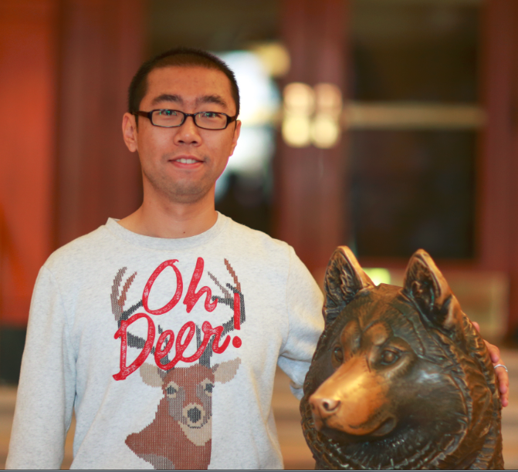
Something about me
Education
Current
Assistant Professor at Department of Computer Science, Brandeis University
Previous
Ph.D. in Computer Engineering, Northeastern University (2014-2018)
Master in Management, Beihang University (2011-2014)
Bachelor in Management, Beihang University (2007-2011)
Minor Bachelor, in Applied Mathematics, Beihang University (2007-2011)
Minor Bachelor, in Law, Beihang University (2007-2011)
Internship
Microsoft Research Asia (6/2017-8/2017)
Adobe Research (5/2016-7/2016)

Slide 3


Research and Publication
Research Objectives
Seek shortcuts in the labyrinth
Handle emerging topics in practical scenarios
Achievements
Publications T-style
Conference - KDD, ICDM, SDM, AAAI, IJCAI, CIKM
Journal - TPAMI, TKDE, TIP, TFS, TKDD, DMKD, BMC
Constrained Clustering
Outlier Detection
Domain Adaptation
Feature Selection
Adversarial Ensemble Clustering
Infinite Ensemble Clustering
Spectral Ensemble Clustering
K-means-based Consensus Clustering
K-means Optimization

Slide 4
Outline
Introduction
Preliminary
Fairness in Unsupervised Learning
Deep Fair Clustering for Visual Learning [CVPR-20]
Deep Clustering based Fair Outlier Detection [KDD-21]
Fairness-Aware Unsupervised Feature Selection [CIKM-21]
Other Related Topics
On Dyadic Fairness: Exploring and Mitigating Bias in Graph Connections [ICLR-20]
Conclusion
Group Fairness
Dyadic Fairness

Slide 5
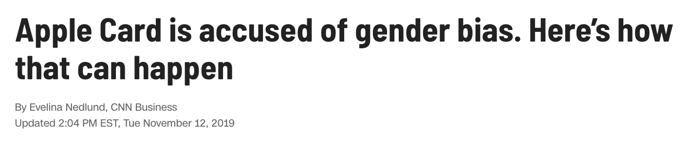
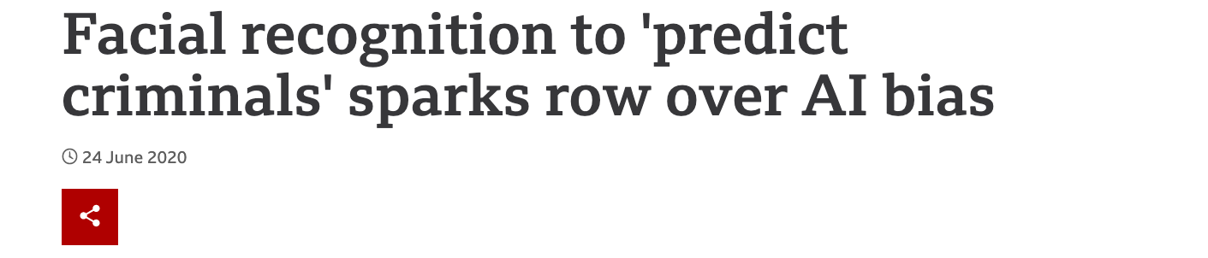
Introduction
Fairness in machine learning has received increasing attention as they gain importance in various fields:
Crime reduction
Healthcare
Advertisement
Public Resources Allocations
...

Slide 6
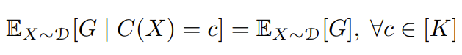
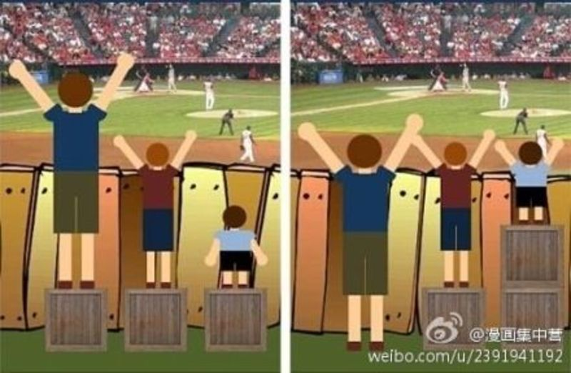
Preliminary
Fairness is revolved around sensitive attributes, such as gender, ethnicity, religion, etc…
Fairness notions: individual, group, subgroup, causality-based, etc…
Debiasing techniques: pre-processing, in-processing, post-processing.
Evaluation: Utility and Fairness

Slide 7

Deep Fair Clustering for Visual Learning
Peizhao Li, Han Zhao and Hongfu Liu in CVPR-20

Slide 8
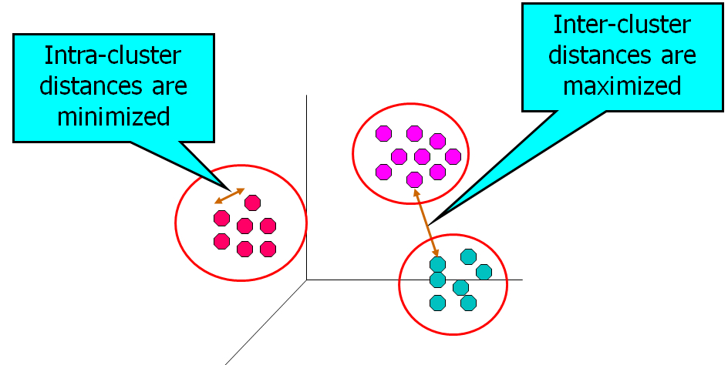


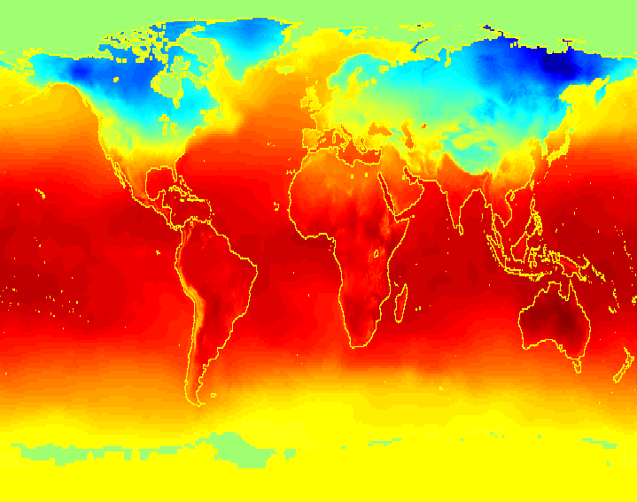

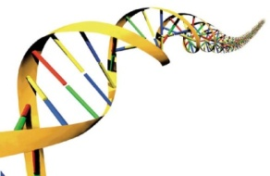
Cluster Analysis
Cluster analysis is a core technique in machine learning and artificial intelligence

Slide 9
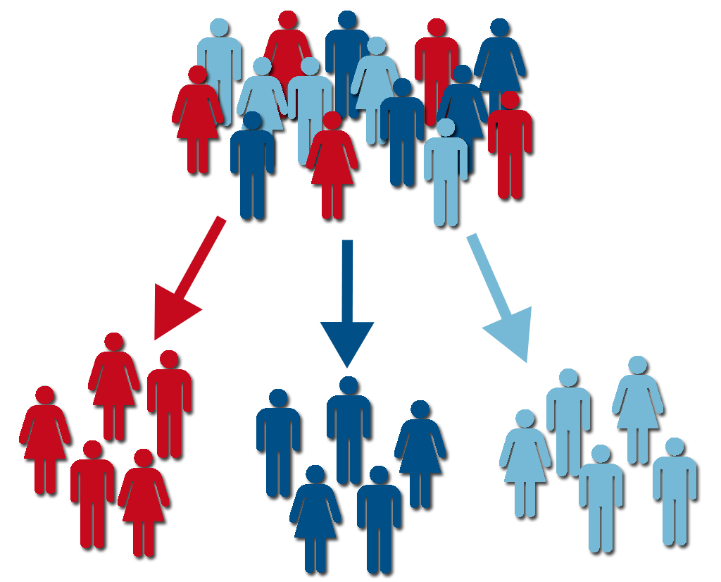
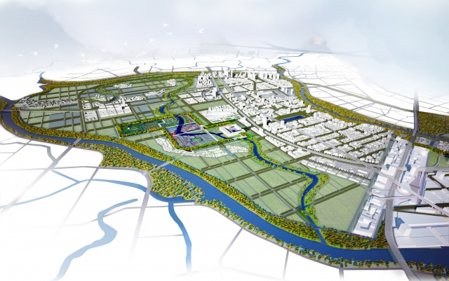
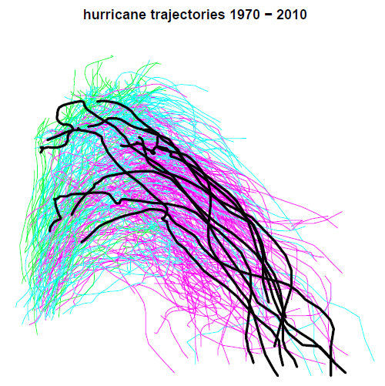


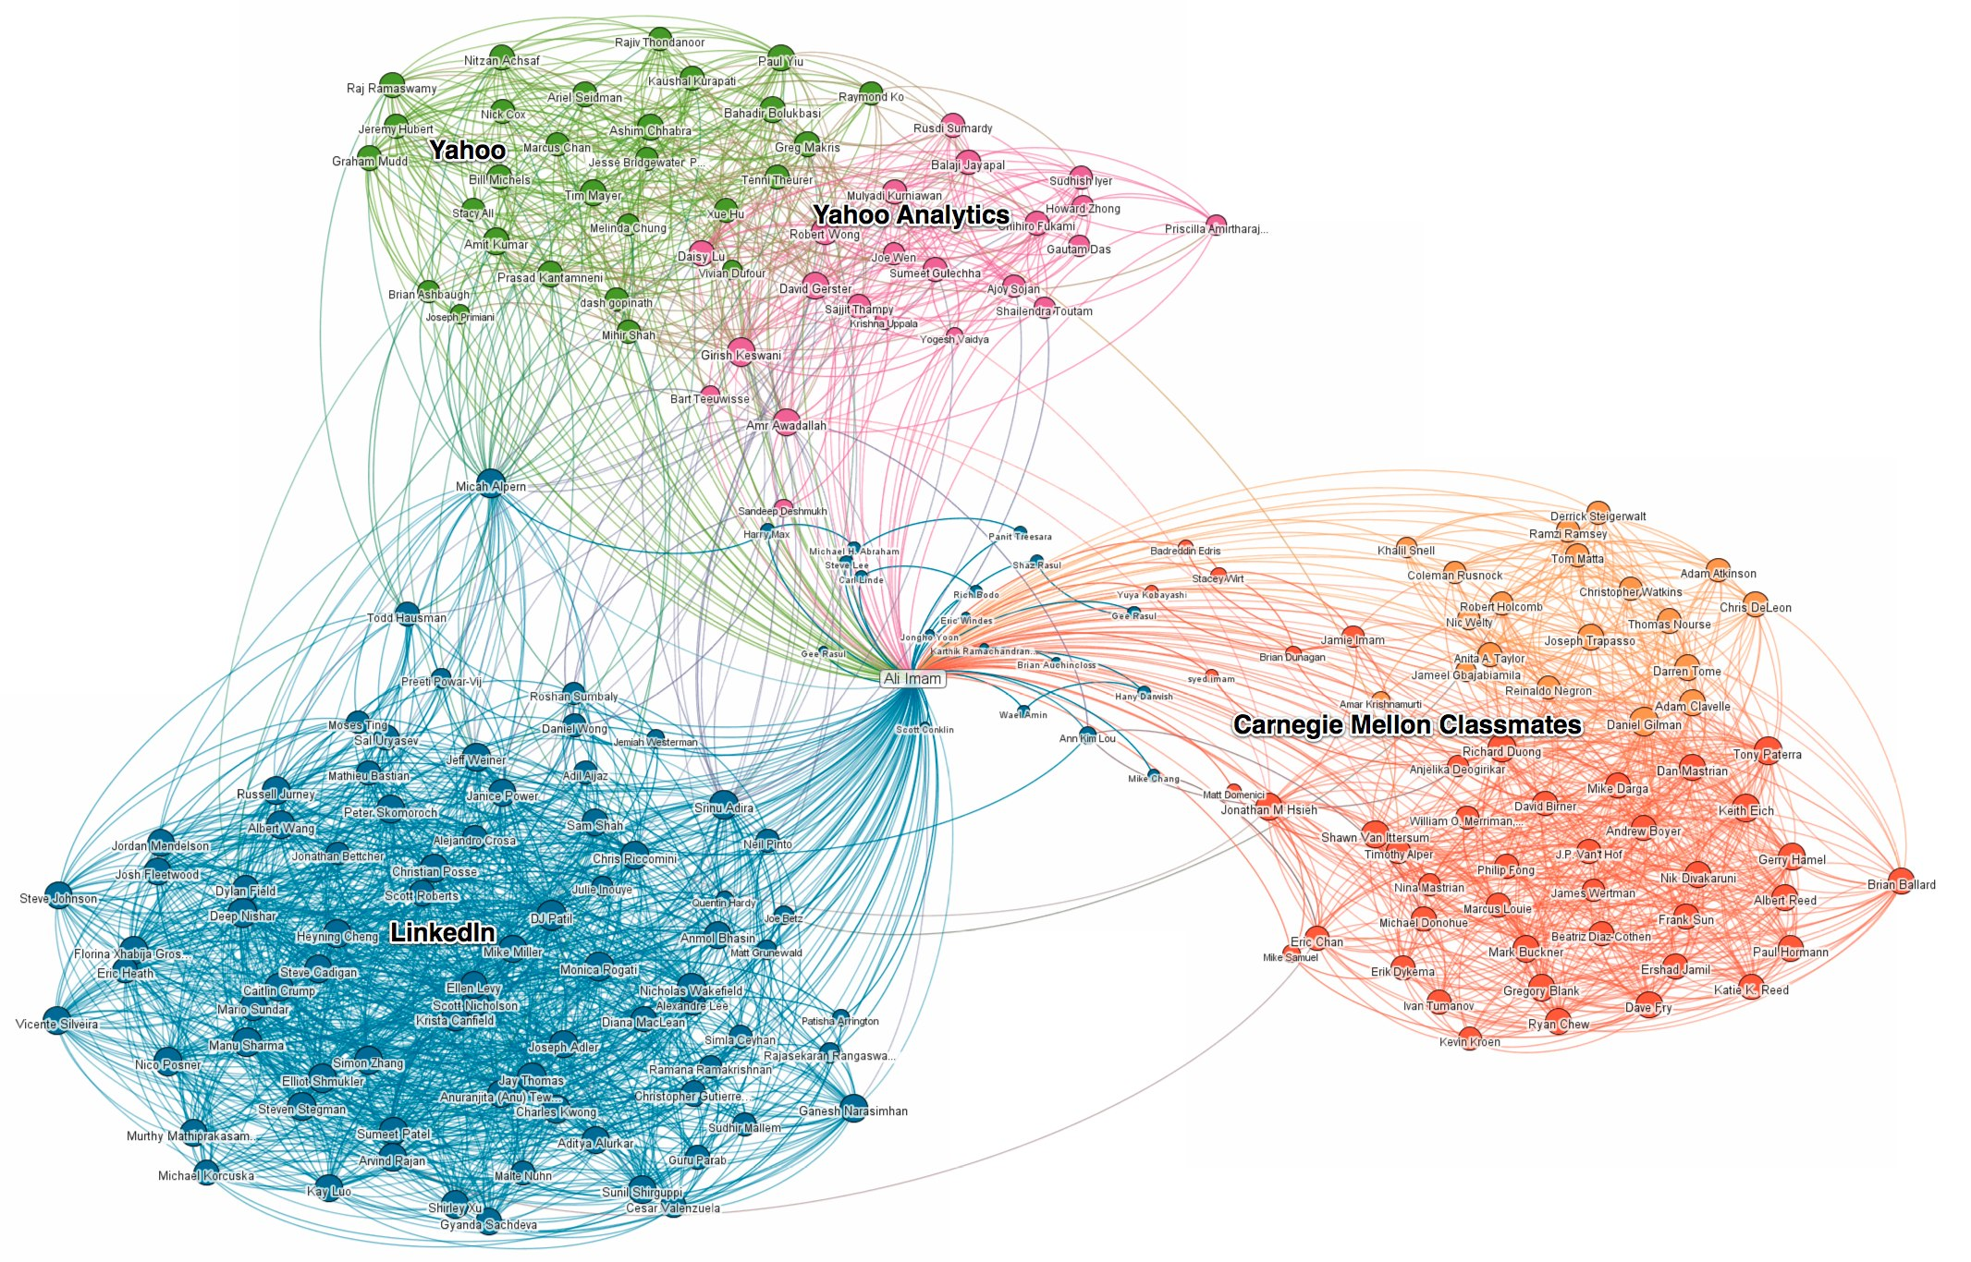
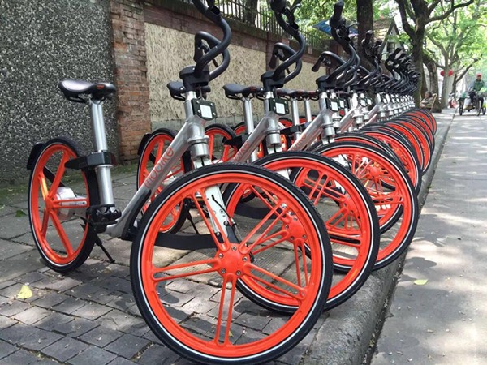
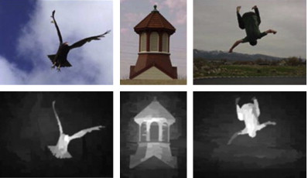
Cluster Analysis
Customer segmentation
City planning
Outlier detection
Superpixel segmentation
Big data visualization
Recommendation system
Resource organization
Saliency detection
By Google images

Slide 10
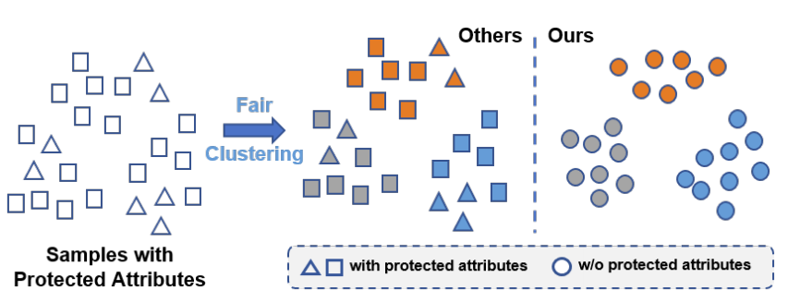
Fair Clustering
Fairness notation: Group fairness
Fair clustering aims to hide sensitive attributes during data partition by balancing the distribution of protected subgroups in each cluster

Slide 11
Motivation and Challenge Analysis
Existing fair clustering methods are usually formulated as the classical constrained clustering problem and solve this problem in the original space.
The input space may limit the clustering performance
Low-dimensional dataset
Balance in terms of absolution value or relative value?

Slide 12
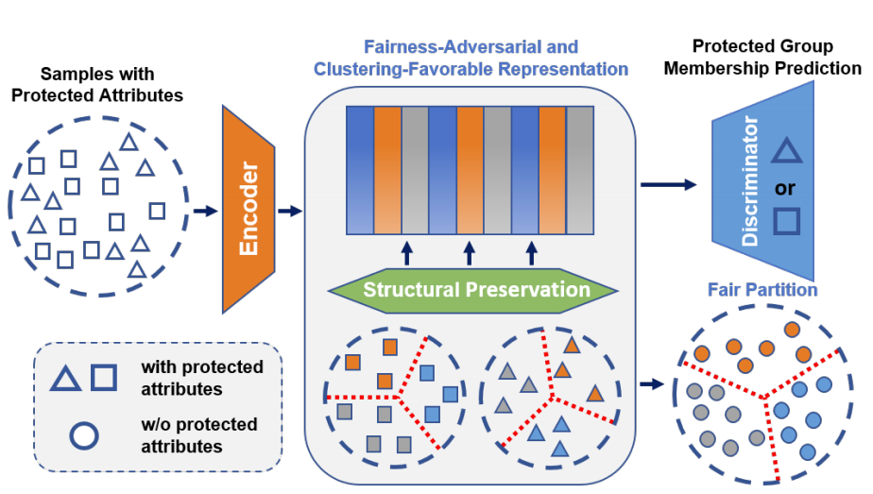
Deep Fair Clustering

Slide 13
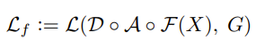
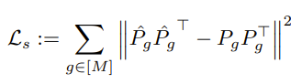
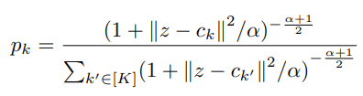
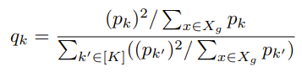
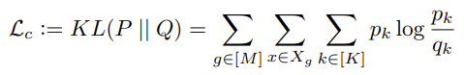
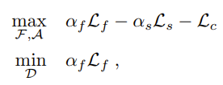
Deep Fair Clustering
Objective Function
Fairness-Adversarial Loss
Structural Preservation Loss
Clustering Assignment and Regularizer
Overall

Slide 14
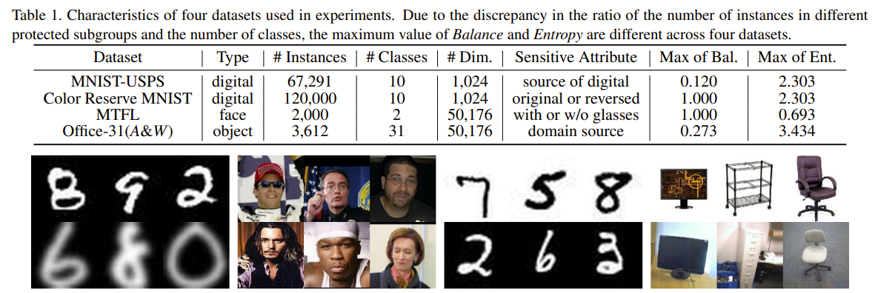
Experimental Result
Datasets

Slide 15
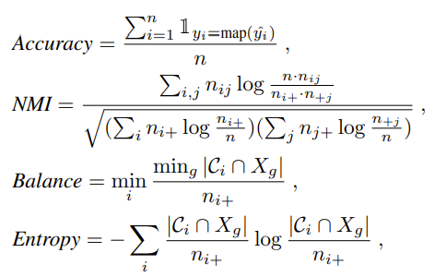
Experimental Result
Evaluation Metric
Utility
Accuracy
Normalized Mutual Information
Fairness
Balance
Entropy

Slide 16
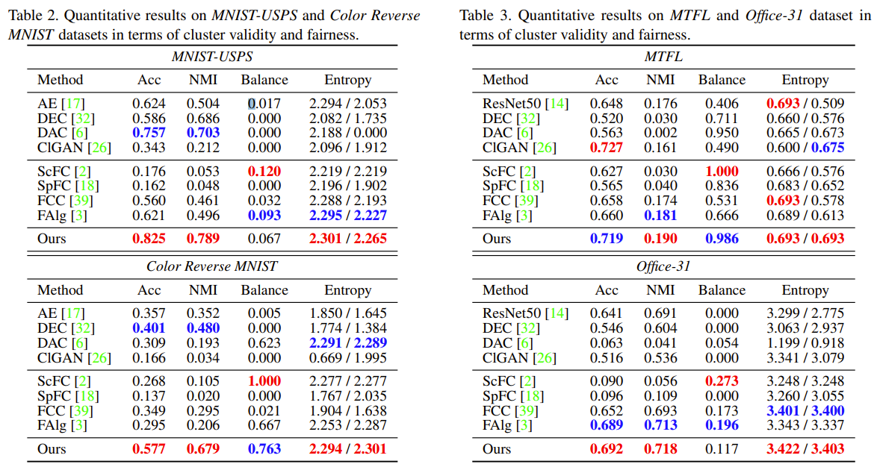
Experimental Result

Slide 17
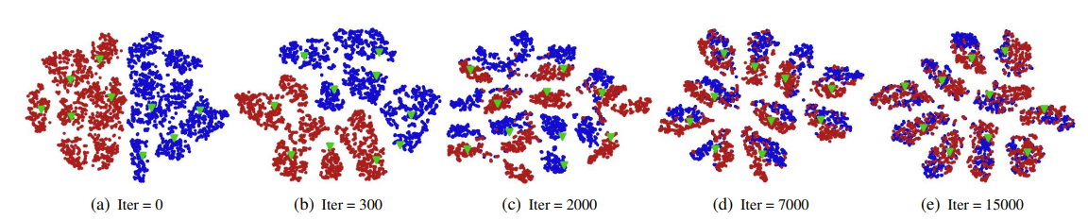
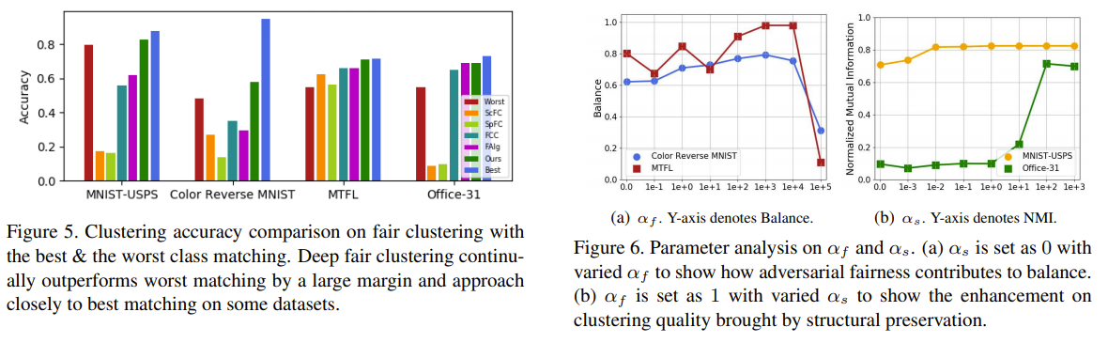
Experimental Result

Slide 18
Summary
We consider fair clustering in the context of deep representation learning for large-scale and high dimensional visual learning. To the best of our knowledge, we are the first to address this problem. Towards the cluster validity and fairness in clustering results, our approach seeks to find feature mappings that are amenable for structure discovery and can simultaneously filter out the sensitive attributes.
We propose a minimax optimization formulation to encourage cluster analysis to be independent of sensitive attributes. Furthermore, we provide a theoretical analysis showing that the fairness constraint in DFC does not cause much utility loss according to cluster validity, which is a desirable property to have.
Extensive experimental results demonstrate the superior performance of the proposed method over several competitors in terms of both cluster validity and fairness measurement. Additionally, we present in-depth explorations, including representation visualization, fairness evaluation, and parameter analysis, to help better understand our fair clustering method.

Slide 19
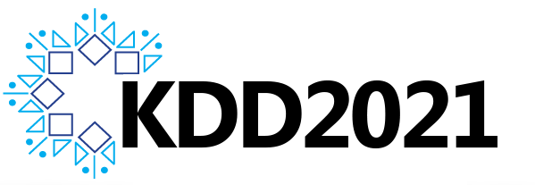
Deep Clustering based Fair Outlier Detection
Hanyu Song, Peizhao Li and Hongfu Liu in KDD-21

Slide 20

Outlier Detection
Detect significant deviations from normal behavior
Applications
Credit card fraud detection
Network intrusion detection
Identify anomalous behavior from sensor networks for monitoring and surveillance
Detecting changes in the global forest cover
High value customer mining
Unsupervised Outlier Detection
Hard
Soft

Slide 21
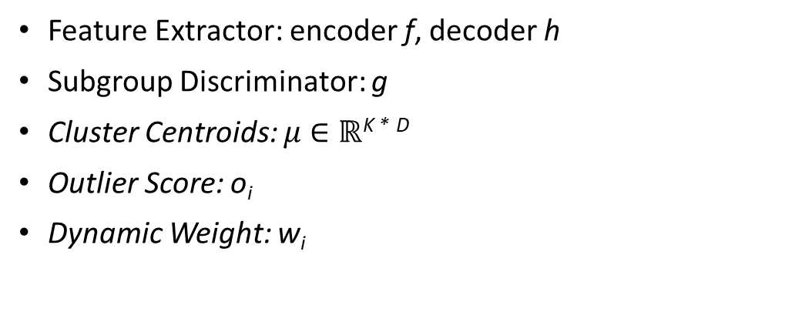
Framework
Data Points with Protected Subgroups
Clustering/Outlier Detection
Favorable Representation
Joint Clustering and Outlier Detection
Feature Extraction
Fairness-adversarial
With sensitive subgroups
Weighted
W/o sensitive subgroups
Outlier Scoring
Cluster centroids
Weight Updating
Feature Extractor: encoder f, decoder h
Subgroup Discriminator: g
Cluster Centroids: $μ$ $∈ℝ$^{K *} ^{D}
Outlier Score: o_{i}
Dynamic Weight: w_{i}

Slide 22
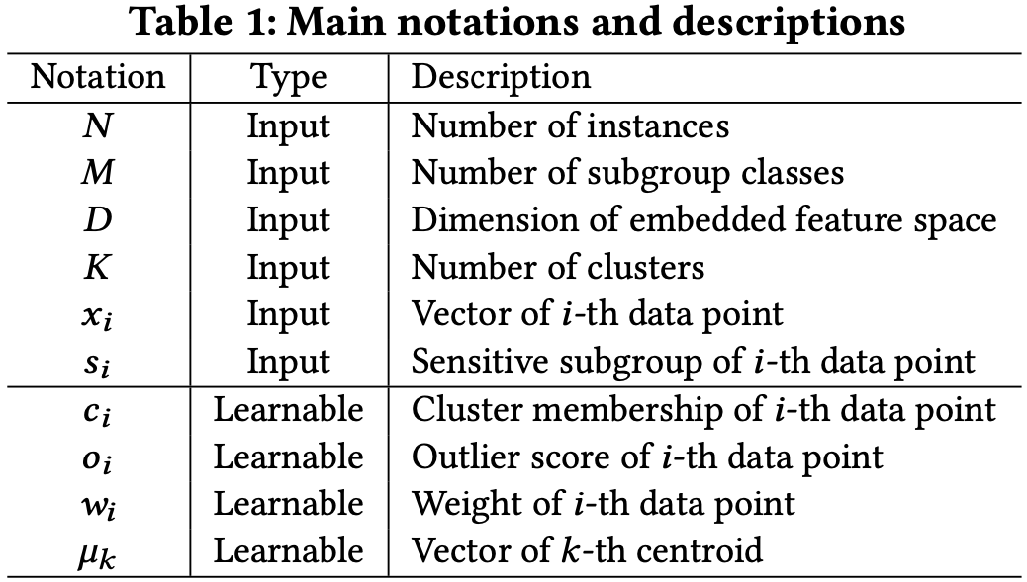
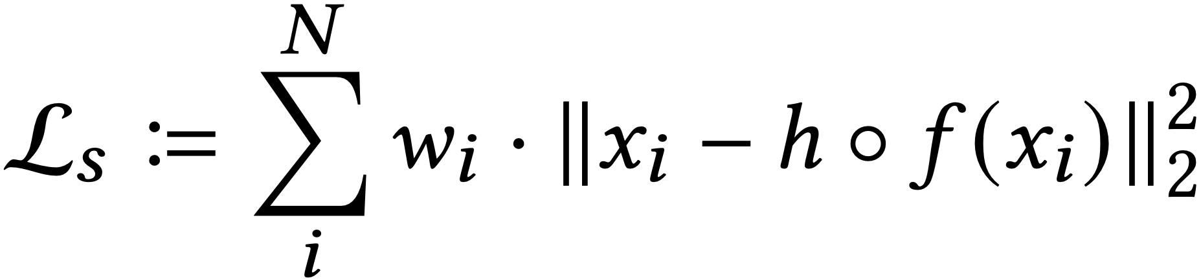
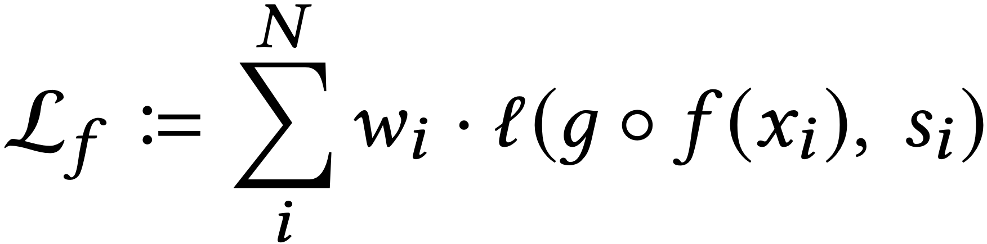
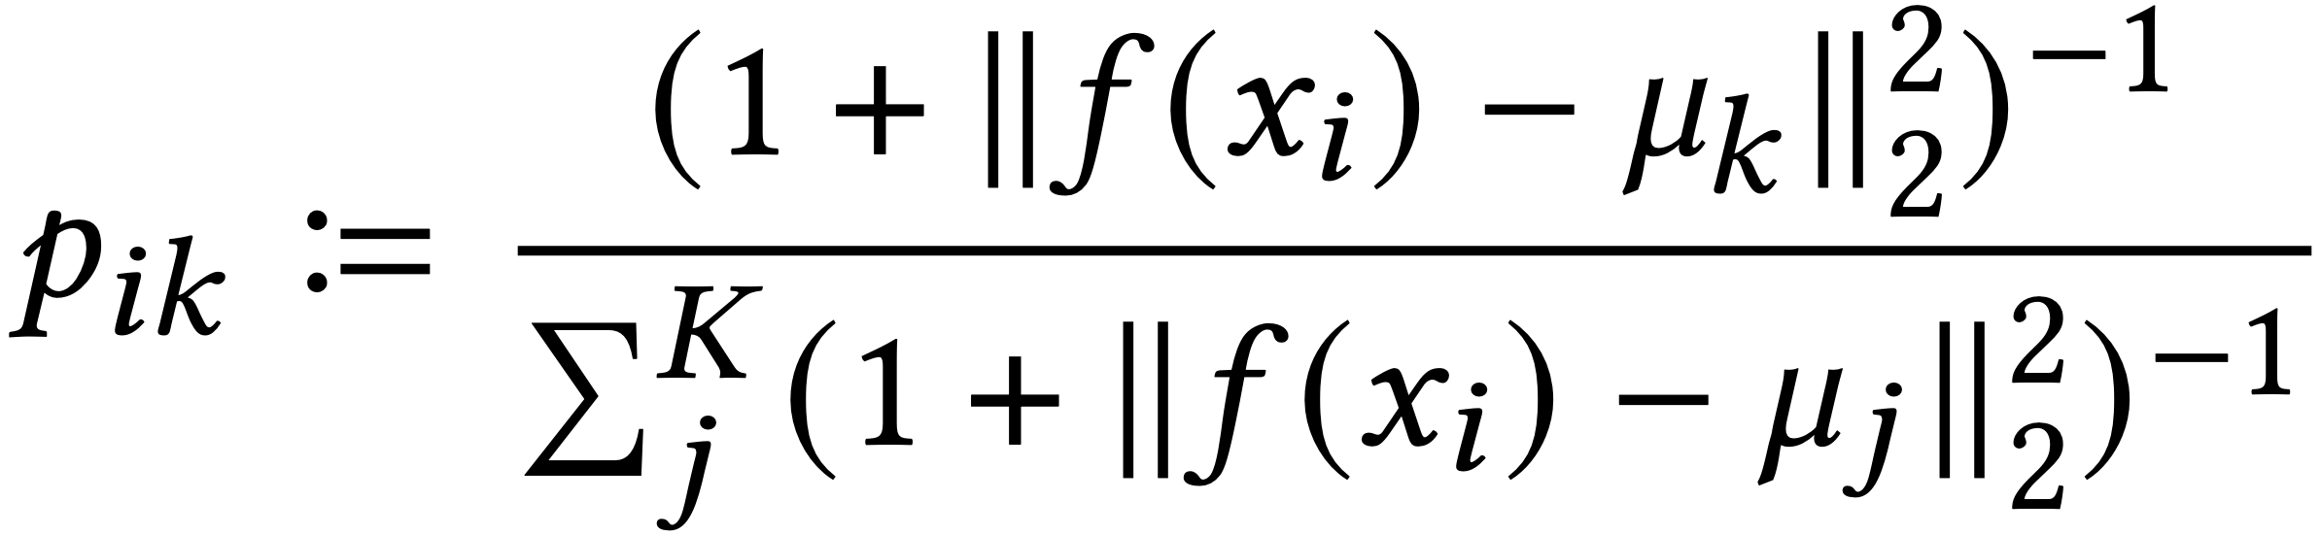
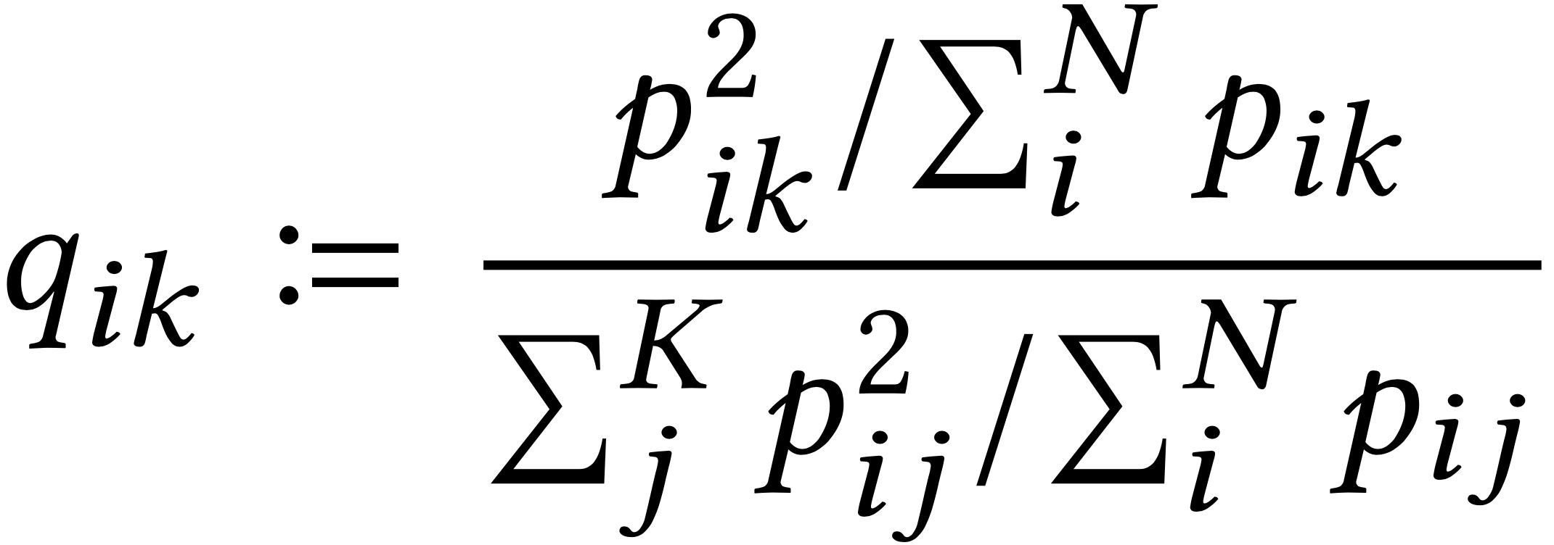
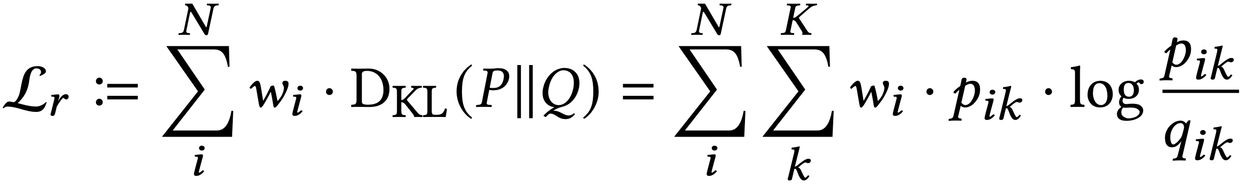
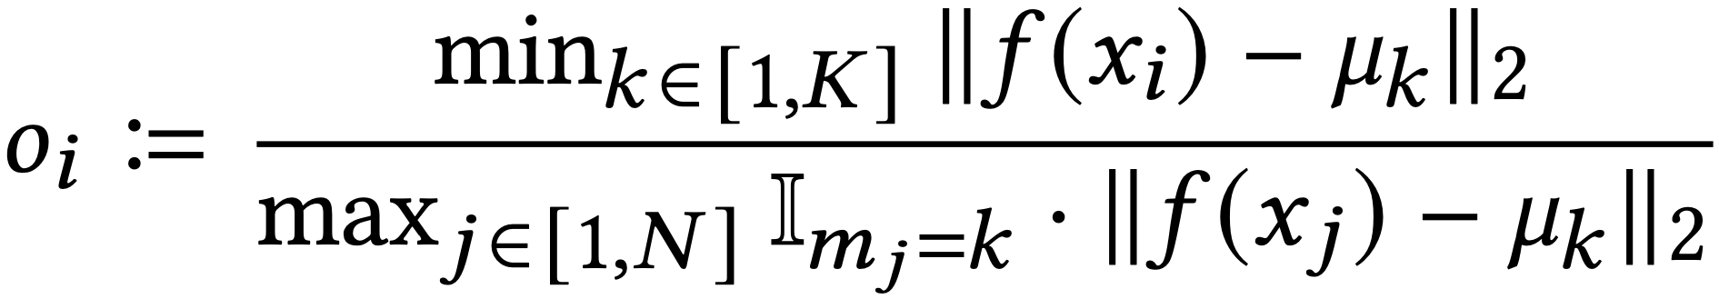
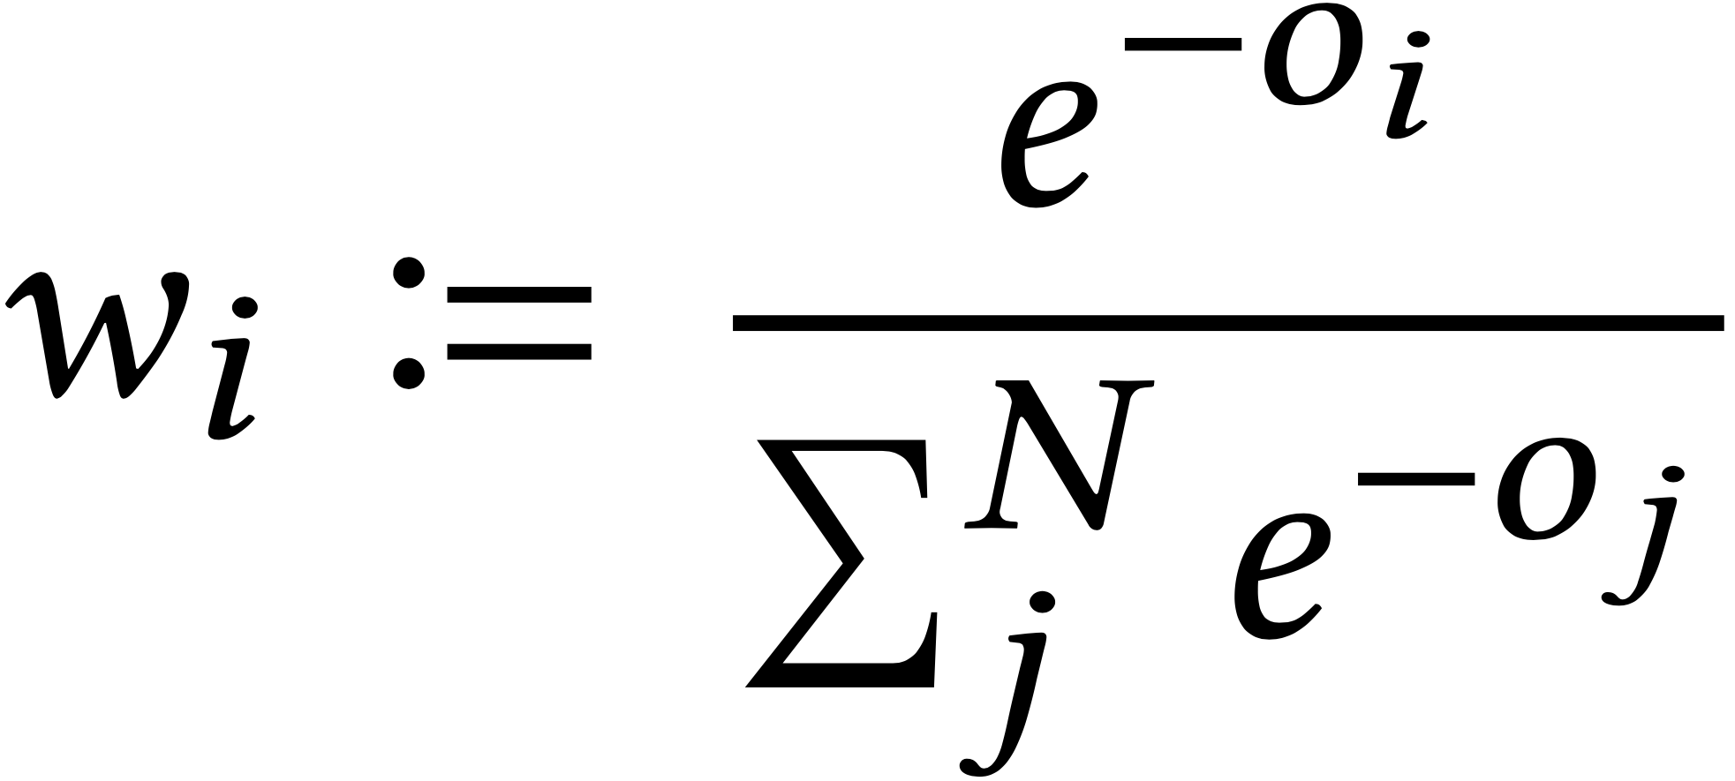
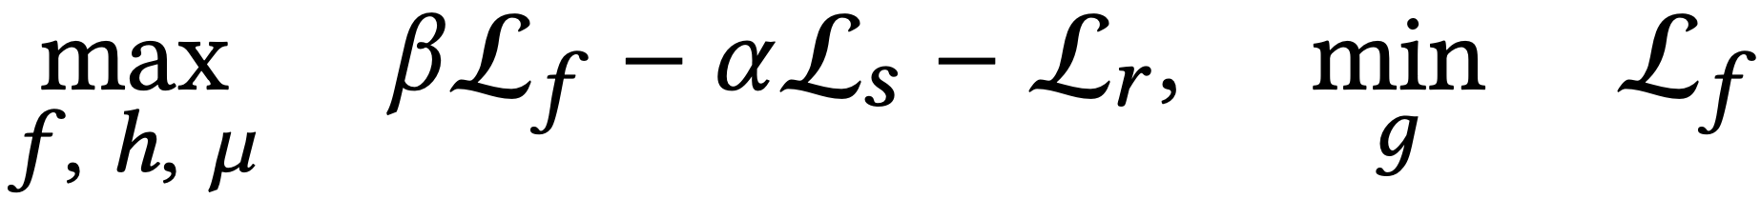
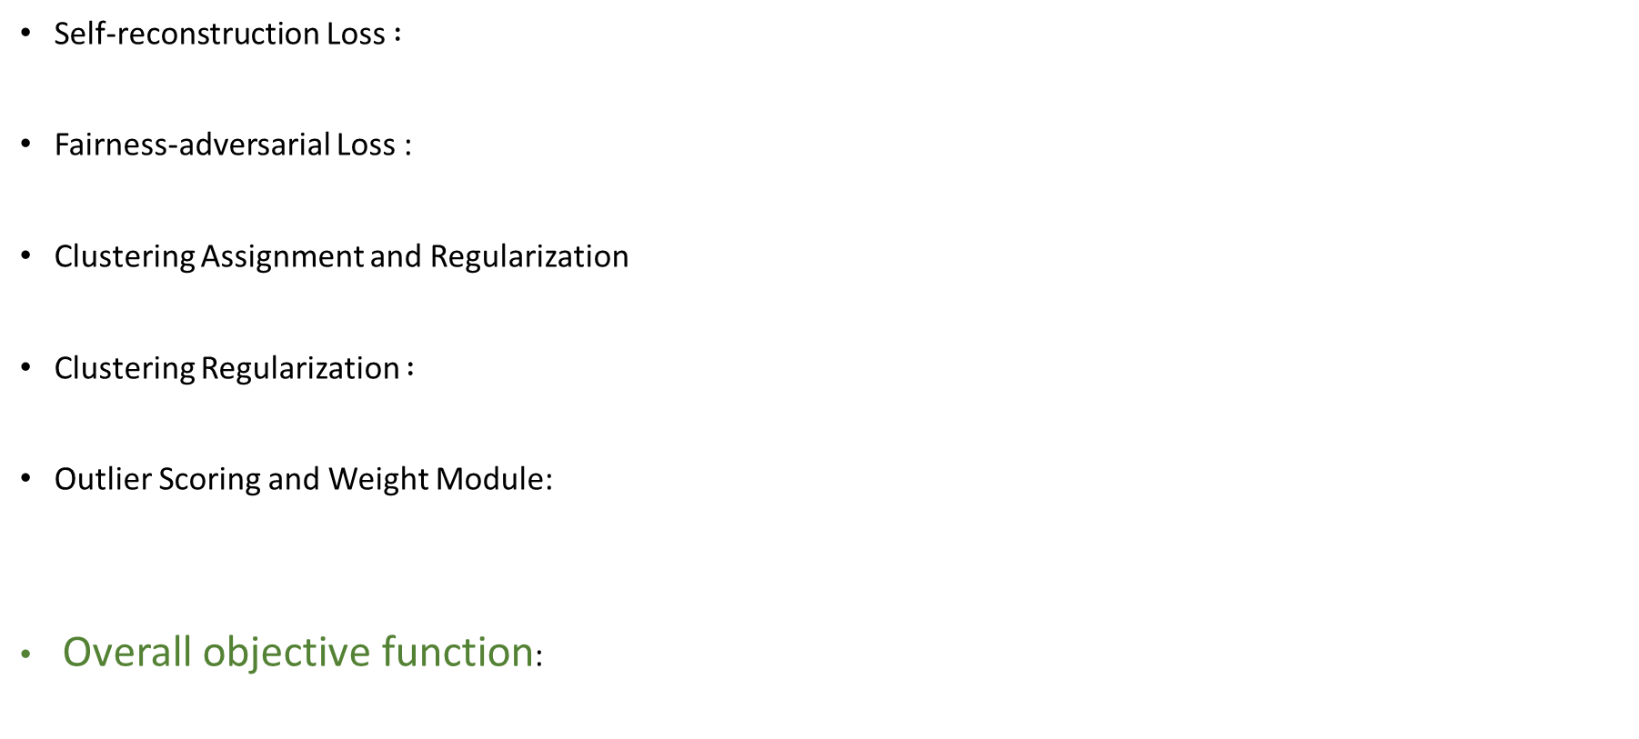
Specifications
Self-reconstruction Loss $:$
Fairness-adversarial Loss :
Clustering Assignment and Regularization
Clustering Regularization $:$
Outlier Scoring and Weight Module:
Overall objective function:
Each datapoints’ distance to the centroids
Distance to its closest centroid
The furthest point among all the
Data points in the same cluster

Slide 23
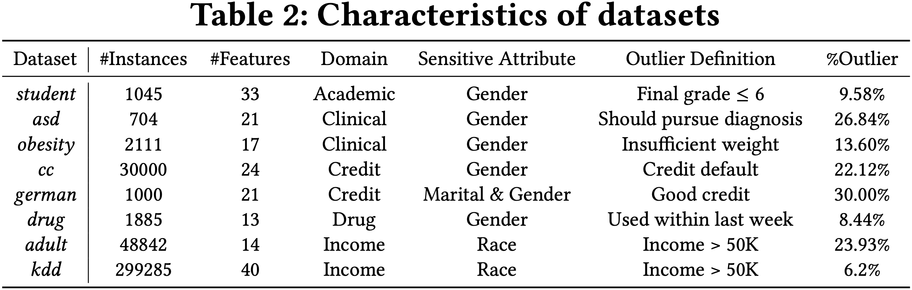
Experimental Results
Datasets

Slide 24
Experimental Results
Competitive Methods
Fair Outlier Detectors :
FairLOF
FairOD
Conventional Outlier Detectors:
PCA
OCSVM
LOF
COF
CBLOF
FABOD
COPOD
FB
iForest
LODA
COR
AE
VAE
RDP
Linear Models
Proximity based
Probability based
Ensemble based
Neural Networks

Slide 25
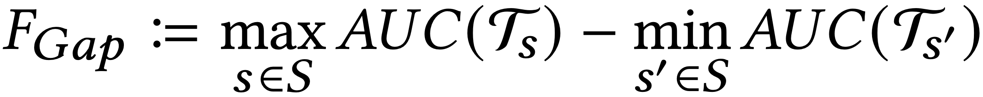
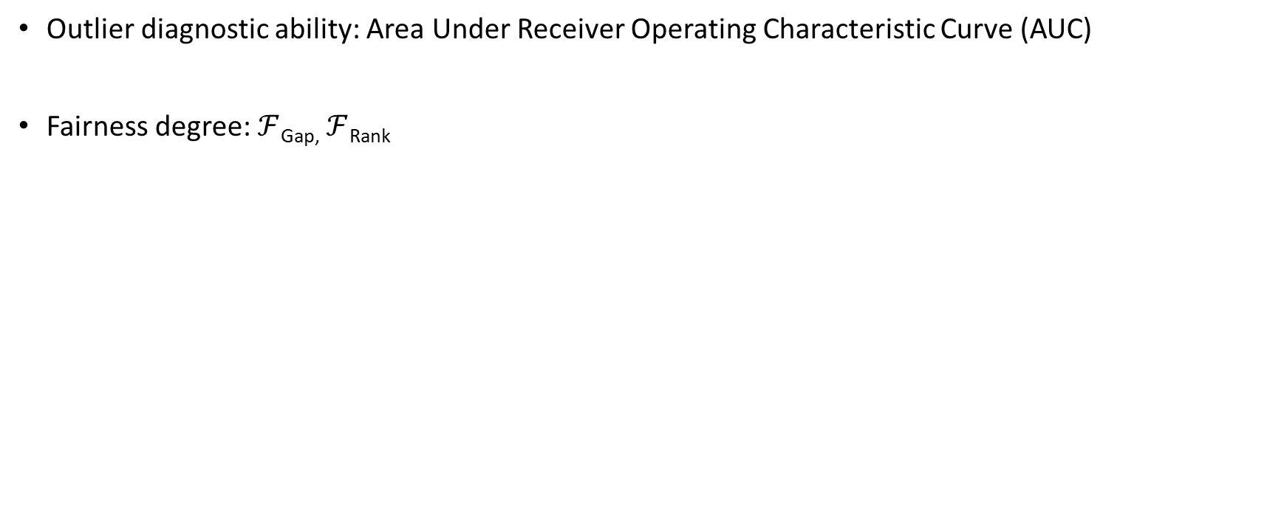
Experimental Results
Evaluation Metrics
Outlier diagnostic ability: Area Under Receiver Operating Characteristic Curve (AUC)
Fairness degree: $ℱ$_{Gap,} $ℱ$_{Rank}
AUC score of datapoints belonging to subgroup s’
subgroup distribution in top outlier candidates
fixed reference distribution in dataset

Slide 26
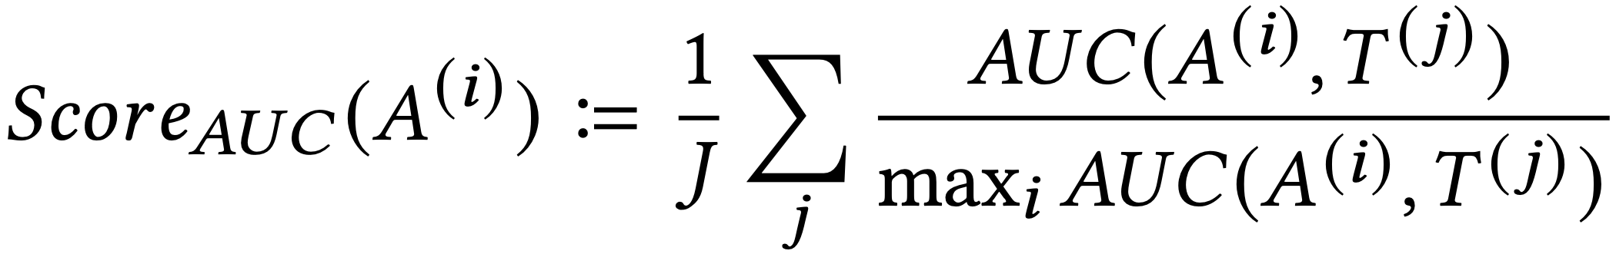
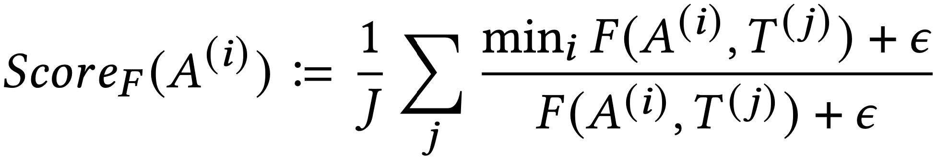
Experimental Results
Model with fairness adversarial training: DCFOD
Model with no fair design: DCOD

Slide 27
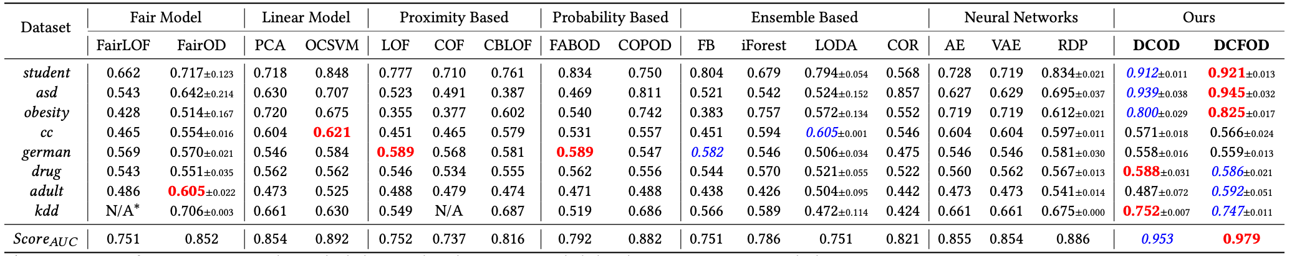
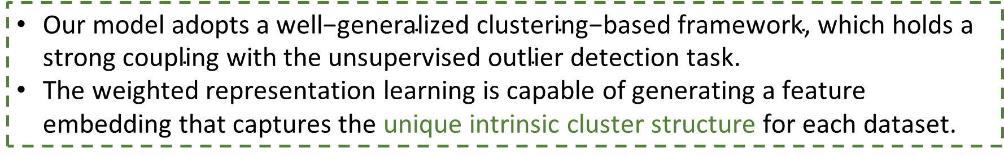
Experimental Results
Outlier validation comparison of 18 algorithms on 8 benchmarks by AUC
$\text{Our} \text{model} \text{adopts} \text{a} \text{well}\text{−}\text{generalized} \text{clustering}\text{−}\text{based} \text{framework}\text{, }\text{which} \text{holds} \text{a} \text{strong} \text{coupling} \text{with} \text{the} \text{unsupervised} \text{outlier} \text{detection} \text{task}\text{.}$
The weighted representation learning is capable of generating a feature embedding that captures the unique intrinsic cluster structure for each dataset.

Slide 28
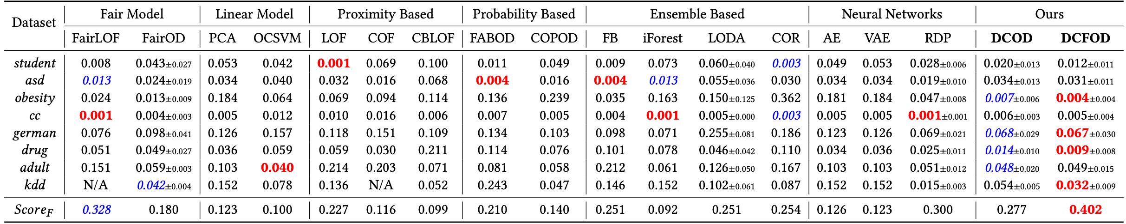
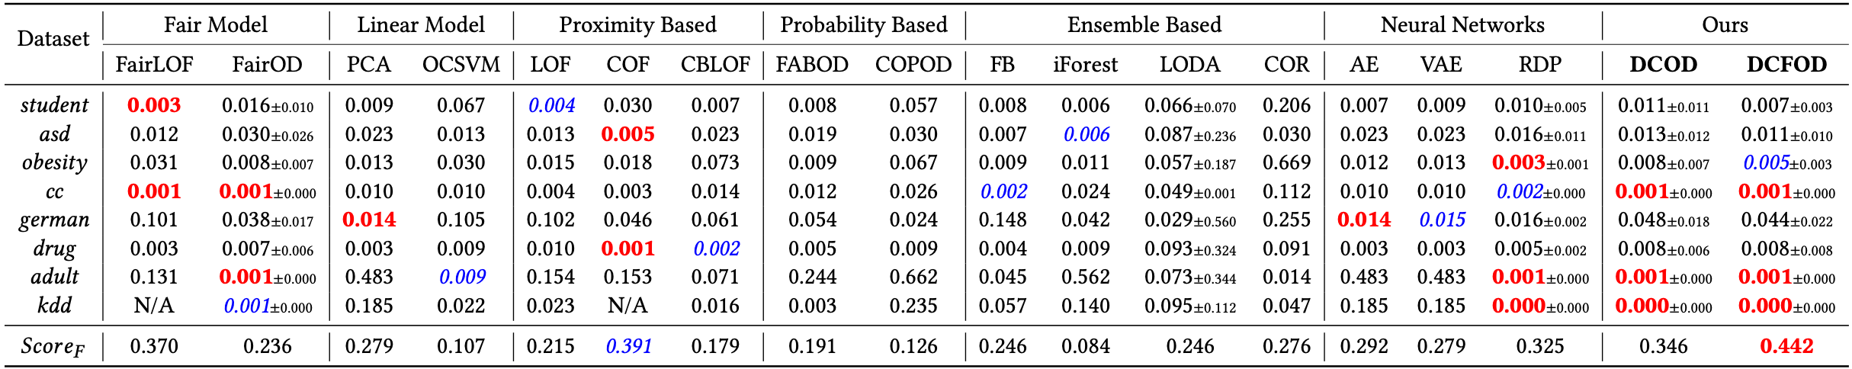

$ℱ$_{Gap} comparison of 18 algorithms on 8 benchmarks
$$seeks a consistent outlier ranking with a baseline detector$$
$$baseline−free, in−processing$$
$ℱ$_{Rank} comparison of 18 algorithms on 8 benchmarks

Slide 29
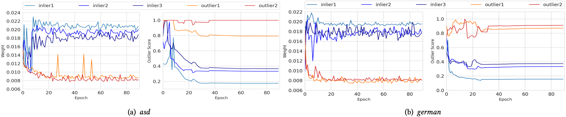
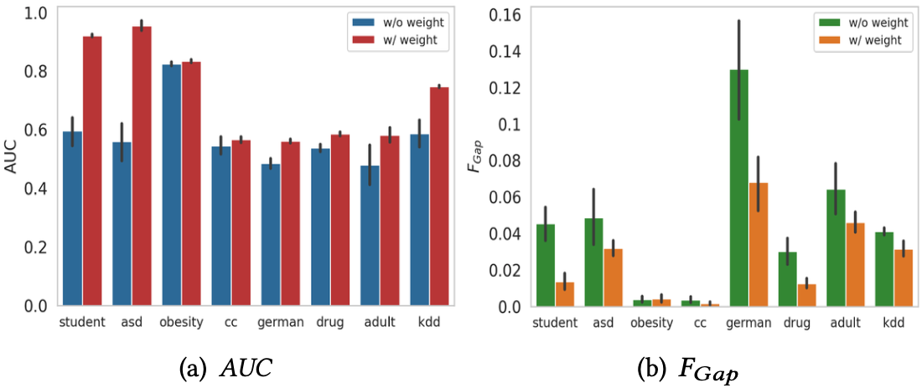


Experimental Results
Weight and outlier trends during training
$$\text{Our} \text{adaptive} \text{weight} \text{module} \text{reinforces} \text{inliers}\text{′ }\text{contributions} \text{by} \text{approximately}\text{ 25\% }\text{and} \text{decreases} \text{that} \text{of} \text{outliers} \text{by}\text{ 50\%.}$$
Effect of weight adjustment on AUC and fairness
$$\text{The} \text{weight} \text{module}\text{′}\text{s} \text{enhancement} \text{in} \text{outlier} \text{validation} \text{invariably} \text{applies} \text{to} \text{all} \text{subgroups}\text{, }\text{thus} \text{closing} \text{their} \text{validity} \text{gaps} \text{and} \text{making} \text{the} \text{model} \text{fairer}\text{.}$$

Slide 30
Summary
Our model adopts representation learning and fairness-adversarial training, with a dynamic weight in regulation of negative impacts from outlier points, to obtain a downstream task-favorable representation while simultaneously ensuring improvement in fairness degree.
We strengthen the fairness measurements in the context of outlier detection by proposing two fairness metrics that test subgroup-wise accuracy gap and subgroup distribution drift in detected outliers.
Extensive experiments on eight real-world public datasets demonstrate evident edge of DCFOD on all metrics in competitions with 17 unsupervised outlier detection methods, including recently-proposed fair outlier detection methods and other conventional outlier detection algorithms.

Slide 31

Fairness-Aware Unsupervised Feature Selection
Xiaoying Xing, Hongfu Liu, Chen Chen and Jundong Li in CIKM-21

Slide 32

Feature Selection
Feature Selection vs Feature Transformation

Slide 33


Fairness-Aware Unsupervised Feature Selection

Slide 34

Experimental Results
4 datasets
Crime
Adolescent
Google+
Toxicity
Evaluation Metrics

Slide 35

Experimental Results

Slide 36



Experimental Results

Slide 37

On Dyadic Fairness: Exploring and Mitigating Bias in Graph Connections
Peizhao Li, Yifei Wang, Han Zhao, Pengyu Hong and Hongfu Liu in ICLR-20

Slide 38

Problem Formulation
We study the problem of disparate impact on graph-structured data with the link prediction application
Fairness notation

Slide 39


How Graph Connections Affect Fairness

Slide 40

Learning Fair Graph Connections

Slide 41

Experimental Results

Slide 42



Experimental Results

Slide 43
Summary
Dyadic Fairness
Graph connections affect fairness
FairAjd algorithm

Slide 44
Conclusion
In this talk, we mainly focus on group fairness and address three unsupervised learning scenarios.
Cluster analysis
Outlier detection
Feature selection
Techniques
Adversarial learning
Kernel learning
Graph modification
Acknowledgement
Team member
Peizhao Li, Han Yue, Wenxiao Xiao
Sibo Zhu, Runjie Lu
Hanyu Song, Hangyu Du, Feng Chen, Zhaonan Li, Zihao Wang
Collaborator
Pengyu Hong@Brandeis
Han Zhao@UIUC
Jundong Li@UVA

Slide 45


Hongfu Liu hongfuliu@brandeis.edu

